Slide 1
Legal Essentials for Software Startups
Founders Circle Workshop by venturelab
Dr Nicolas Mosimann, LL.M.
startup space, Schlieren, 16 November 2016

Slide 2
Kellerhals carrard Startup Desk: Our Services
Our Startup Desk comprises a core team of motivated and experienced lawyers from Basel, Berne, Lausanne and Zurich. We offer professional, pragmatic and reliable services in all areas and phases of life of a startup.
A main focus is advising startups in connection with
financing rounds
incentive plans
exit transactions (trade sale, IPO)
IP-related matters.

Slide 3














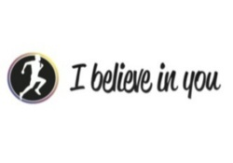















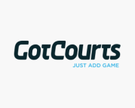






References (Selection)

Slide 4


Today‘s Agenda?

Slide 5
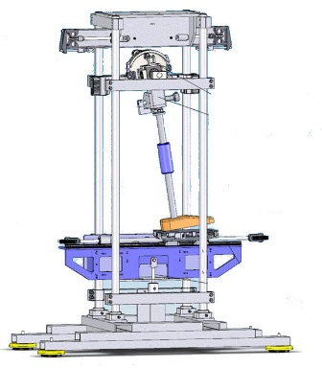



Slide 6
I Ip relating to…?
Coporate identity
trademarks
domain names
right to company name
copyright (logo)
(social media)
Product/service
trademarks
patents
design rights
copyright
(confidentiality)
etc.
Not essential in every case, depending on product/service
In most cases relevant
Notes:
I assume you guys know all about the very basics of IP protection. Trademark, copypright, patents etc. Now to what exactly do they relate? What
Unternehmensauftritt: Kaum ein Unternehmen, für das die Rechte am eigenen Namen/Auftritt nicht essentiell sind.
Produkt: je nach dem schneller Markteintritt wichtiger, Know-how entscheidend, bestehende Kundenbeziehungen/Netzwerk/Infrastruktur etc.
Unternehmenswert hängt in der Regel davon ab (stärker oder weniger stark)

Slide 7


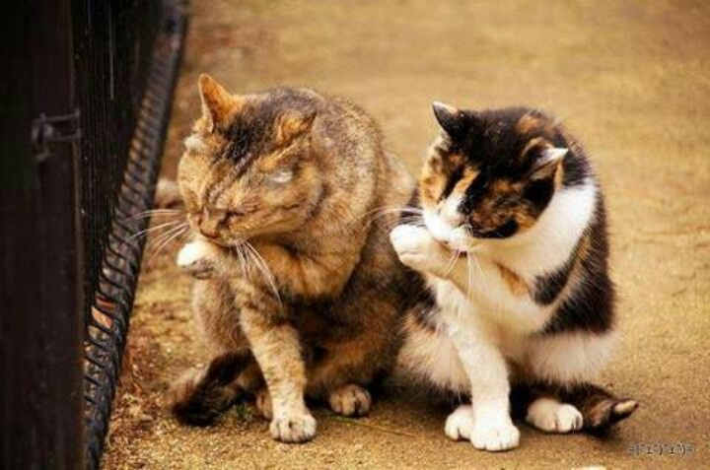

I IP = $$$
Protection
Avoidance of disputes

Slide 8
II Do‘s and Dont‘s: company Name and product name
Competitior with similar or identical name/designation → research
Weak or not registrable name
Protection for relevant goods/services and territories
Do not forget about social media
Company must hold all rights/accounts, have all passwords
Minor mistakes (at early stage) with big risk potential (in future)

Slide 9
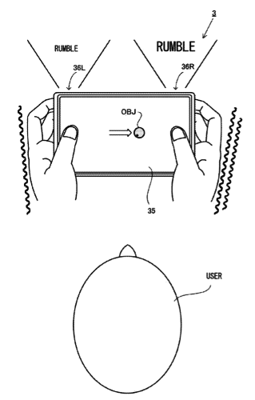

III Do‘s and Dont‘s: protection of product
1. Rights in software
2. No infringement of third party rights
Patent Attorney
Notes:
Software: Grosse Bedeutung (IT Startups, Fintech, aber bei anderen Technologien/Bereichen)

Slide 10
IV Protection of Software: Applicable Law (Basics)
International context
  Global distribution/licensing of software
  International development teams with different places of work
Applicable law is to be determined
  Parties are free to choose the law applicable to agreements (with some exceptions).
  The law applicable to IP rights follows the principle of territoriality. No choice of law.
Think globally!

Slide 11
V Protection of Software
Copyright
  Protection : „computer programs“ (source code, object code, documentation, graphical user interface)
  No protection: idea, concept, function
  50 years
Patent
  Software as such not patentable (i.e. no solution of a technical problem)
  Computer implemented inventions can be protected
Design right
  Protection of graphical user interface
Notes:
Urheberrecht: international anerkannt: Art. 4 WIPO Copyright Treaty (geschützt als literarisches Werk gemäss Berne Convention)
Software bzw. Computerprogramme sind durch das Urheberrecht geschützt. Dabei schützt das Urheberrecht die konkrete Implementierung, also den Programm-Code, nicht aber ein Verfahren, das einem Computerprogramm zugrunde liegt. Ohne gegen das Urheberrecht zu verstossen, ist es möglich, dieselbe Idee in einem anderen Computerprogramm umzusetzen oder eine Software mit einer gewissen Funktionalität nachzuprogrammieren.
Es wäre also naheliegend, Software mittels Patenten zu schützen. Patente dienen dem Schutz technischer Erfindungen, also neuen und nicht naheliegenden Lösungen technischer Problemstellungen. Grundsätzlich jedoch sind in Europa Computerprogramme als solche vom Patentschutz ausgeschlossen. Reine Textverarbeitungsprogramme beispielsweise lösen kein technisches Problem und sind daher nicht patentierbar. Anders sieht es hingegen aus, wenn Computerprogramme dazu dienen, eine technische Erfindung umszusetzen. Solche "computer-implementierte Erfindungen"sind unter gewissen Umständen durchaus patentfähig.

Slide 12


VI Securing IP rights in the software (1)
University / former employer
Founder
Dev Co
Startup
Freelancers/
cooperation partners
Employees
Notes:
Founder: Lizenzverträge von Uni oder Erlaubnis/Übertragung von ehemaligem Arbeitgeber

Slide 13
VII Securing IP rights in the software (2)
Written assignments / deed of assignments
Content:
  Transfer of all rights relating to work results (including future exploitation rights)
  Scope of work/job description essential
  Duty to contribute to registration (if necessary)
  Waiver of moral rights to the extent permitted
  Unlimited license to the extent a transfer is not allowed (remember: principle of territoriality)

Slide 14


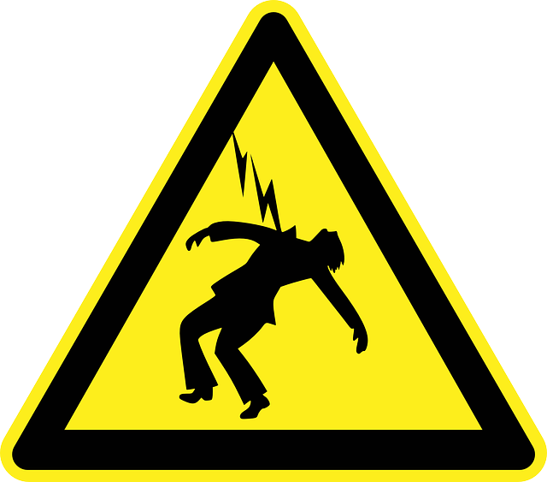
VIII no infringement upon third party rights (1)

Slide 15
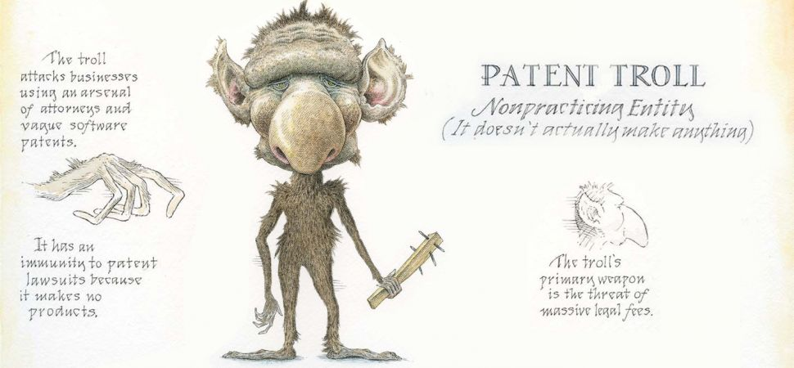
VIII no infringement upon third party rights (2): third party patents

Slide 16
VIII no infringement upon third party rights (3): third party patents
$
Licensor
Licensee
$
$
Patent Troll

Slide 17
VIII no infringement upon third party rights (4): third party patents
(US-)patens
  Patent research: expensive
  Risk varies (e.g., US vs. Europe)
  Insurance difficult/expensive
  Limitation of obligation to indemnify?

Slide 18




VIII No Infringement upon third party rights (5): Copyright
Plagiarism
  Use of OSS with strict copyleft
MIT License
Measures
  Developers‘ guidelines (employment agreement, directives)
  Reps and warranties by third party developers
  Source code reviews (internally and externally)
  Limitation of obligation to indemnify?
Notes:
SaaS model can be problematic if certain (older) licenses are used.

Slide 19
VIII No Infringement upon third party rights (6)
Obligation to indemnify customers:
  Exclusion: B2B vs. B2C
  Market standard indemnity language (B2B)
    Control of litigation
    No settlement without licensor’s approval
    Limitation in territory?
    Limitation to damages awarded by final court decision
    Exclusion of lost profits
    Cap?
IP rights in separate entity

Slide 20
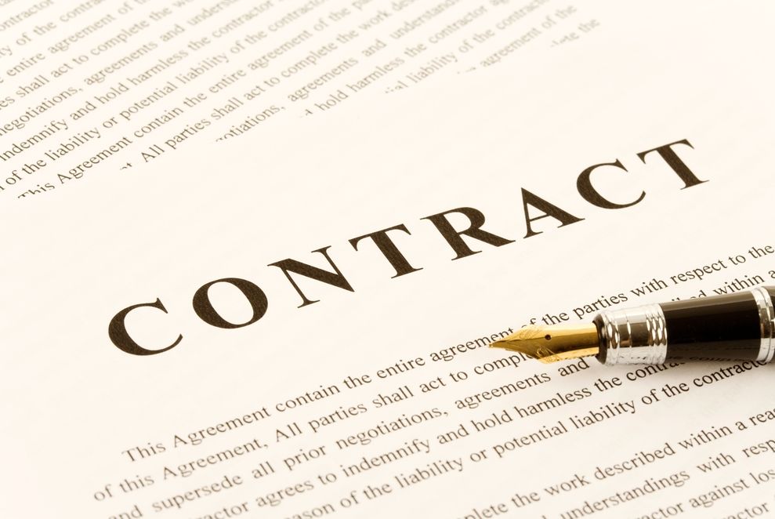
IT Agreements
IT Agreements
The Vendor‘s Perspective
The Vendor‘s Perspective

Slide 21
I The Basics: What is an Agreement?
Offer: One off license, 2 users, CHF 20‘000.00
Accept: Great, we have a deal!

Slide 22
I The Basics: What is this all about?
Clear terms and conditions governing the relationship
Continuity/stability
Allocation of risks
Legal enforcement of rights
Enterprise value (due diligence)

Slide 23
II Know your Client: Who is party to the Contract?
Contractual obligations only oblige the parties to the agreement
Which party can I sue?
Shady Inc. ≠ Shady Group
What is the contracting party‘s solvency/capacity to pay?

Slide 24
III License: What is a license?
Right to do something with something, e.g.
  use, modify, exploit, reproduce, display, access, produce
  Software (object or source code), music, film, recipe/formula, drug, plan, concept, trademark, design, patent
E.g.:
  Produce and sell Coca-Cola using the secret formula (i.e. know how) and the Coca-Cola trademarks.
  Offer a band‘s record via a streaming service
  Install and use a software
  Use a SaaS

Slide 25
III License: Why does the Customer need one?
Startup owns intellectual property rights relating to the software
IP rights: monopoly to exploit and oppose any unauthorized use
IP rights can be enforced against anyone
  Customers need permission to use startup’s source
  or object code

Slide 26
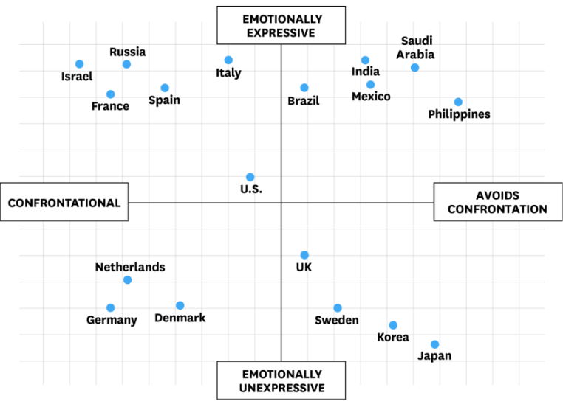
IV Negotiating an Agreement
© HBR.ORG

Slide 27
IV Negotiating An Agreement
Give reasons/explain!
„You will understand that we cannot do this because…“
You must understand the agreement and each party‘s interests

Slide 28
VI License Agreements: Key Terms and Interests
Topic/Clause | Startup’s Interests
Scope of license | Key business term User groups, territory, afiiliates, third parties, usage
Term and Termination | Fixed term, green clause, stability, enterprise value No change of control clauses Used soft cases
Availability and warranty | Only best efforts No (specific) warranty (as is)
Liability | Limitation of liability as a result of software errors, bad support or violation of third party rights

Slide 29
VI License Agreements: Support and Warranty
Further key terms:
  Documentation (online, as amended from time to time)
  System requirements
  Reproduction on in-house installation
  Product support (i.e. 3rd level support)
  No resolution time – just best efforts
  No support of outdated versions / obligation to upgrade

Slide 30
VI License Agreements: Liability
Beware of:
  liability for lost profits
  uncapped liability for direct/indirect damages
Exclusions/limitations
  Exclusion of indirect damages (including lost profits)
  Part of the pricing
  Startup is not able to bear client‘s business risk
  Cap in the amount of yearly license fees

Slide 31
VII Maintenance and Support Agreements
Description of services
Definition of provider’s obligations (duty of care, guarantee of results)
1st level, 2nd level, 3rd level support?
Exlusions of certain support cases?
Communication (ticketing system, call center)
Service levels
Service credits
Price: flat fee, on a time spent basis, capped?

Slide 32
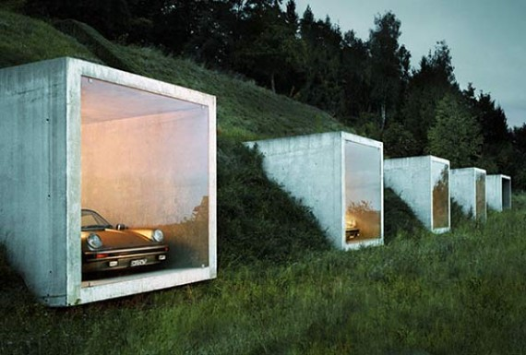
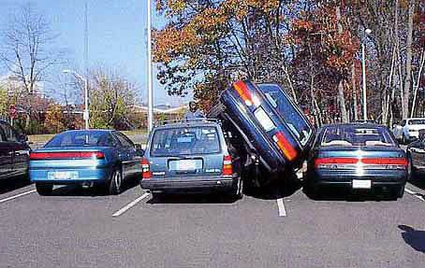
VIII hosting agreements
In practice (B2B)
  Contractual obligations/services often not clear
  A mere SLA is worthless
  Ask questions!
© http://www.therichtimes.com/car-safety-lockers-are-the-ultimate-in-luxury-parking/
Notes:
Wie gross und komfortabel ist der Parkplatz? Parkwärter? Putzservice? Überdacht? Geheizt?

Slide 33
VIII hosting agreeements: Key Deal points
Desciption of services
Dedicated server vs. shared/virtual server
Redundancy (network, hardware, power, geographic)
Audit rights
Availability: it’s about the details!
Service credits
Service continuity (e.g. arrangements with third parties)

Slide 34

VIII hosting agreeements: SLA
Service Levels
  99.5%, 99.95?, 99.80%?
  Service availability and service credits

Slide 35
VIII hosting agreeements: SLA
  Service level example: „Service availablilty of 99.5%“
    Service measurement period: „on yearly average“ → 44 hours (almost two days) of downtime possible; on a monthly basis 3.6 hours (per month)
    Exclusion of maintenance time (no limit)
    Only applies in the event of a total fail of service, not if only partly impaired
    Calculation of downtime only after 4 hours of notice of such downtime
    Only if permitted usage not exceeded
    Point of measurement: only if downtime is registered by provider’s systems
  Availability as guarantee (selbständige Garantie)?
Notes:
Das Kleingedruckte ist entscheidend!
Bedarf an Verfügbarkeit kommt extrem auf Geschäftsmodell des Kunden an: z.B. E-Commerce vs. Metallfabrikant
Kosten sehr unterschiedlich
Eine Garantie ist also auch Beschränkung der Leistungspflichten

Slide 36
IX Jurisdiction and choice of Law
  Courts in Switzerland/Swiss law:
    Home field advantage (low costs, language, bias of judges?)
    Choice of law and jurisdiction clause should be in line

Slide 37
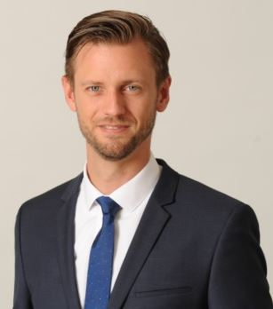
Good luck and get in touch in case of questions!
Nicolas Mosimann
Attorney at Law, Dr, LL.M.
Hirschgässlein 11
Postfach 257
4010 Basel
Switzerland
nicolas.mosimann@kellerhals-carrard.ch

